Slide 1
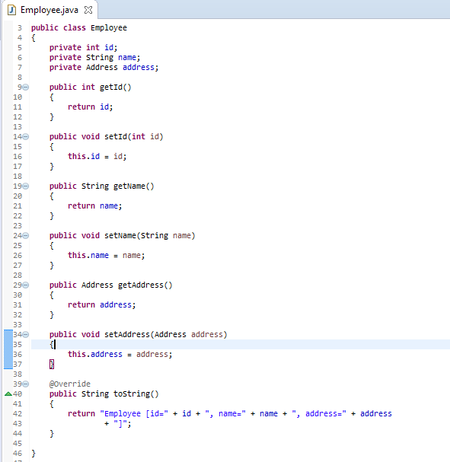
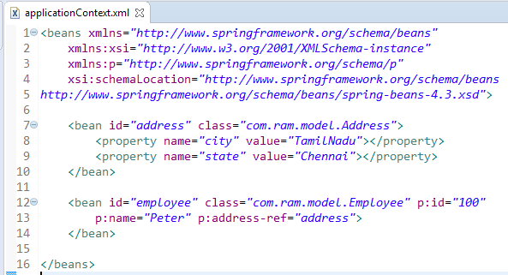
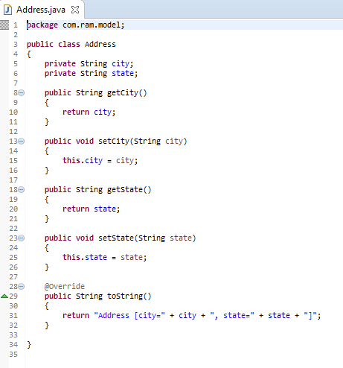
Spring’s p namespace in XML configuration
In configuring bean’s in Spring, traditionally we use <property> element to set property for any bean. Instead of using <property> element to set each property in bean , Spring’s p namespace offers a way to wire bean properties that doesn’t require so many angle brackets (<>).
The p namespace has a schema URI of http://www.springframework.org/schema/p

Slide 2
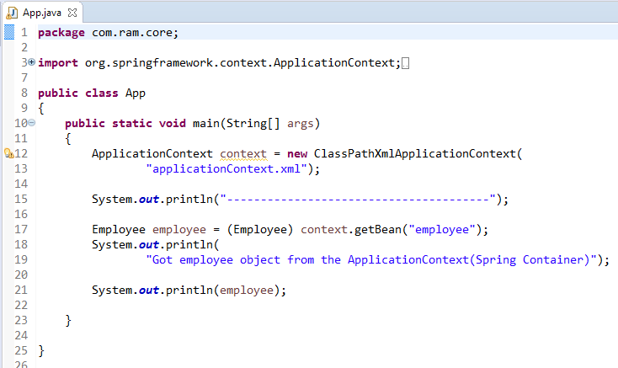
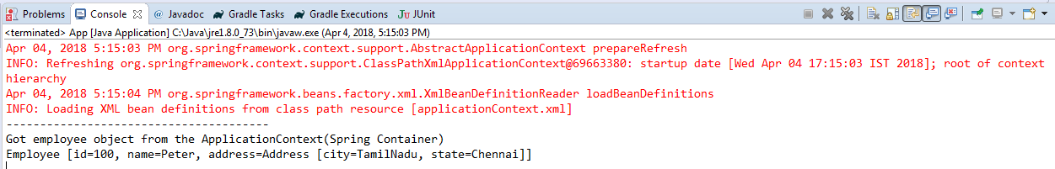
Spring’s p namespace in XML configuration

